Slide 1



QMM FINAL GROUP PROJECT PRESENTATION
PRESENTED BY:
Manasa chelukala
Yash Bhanushali
Swetha Kanakavalli

Slide 2
Choice of factors:

Slide 3

Data Collection
Course administrators should have no problem collecting student grades.
Other factors can be collected by survey/questionnaire or by showing hands during class.

Slide 4
Model Formulation – Decision Variables
Decision variables are members of groups. We used H[i,j] as the decision variables.
A value of H[i,j] indicates whether a student belongs to the group in which the student is jth.
Each group has three students out of 12 students.

Slide 5

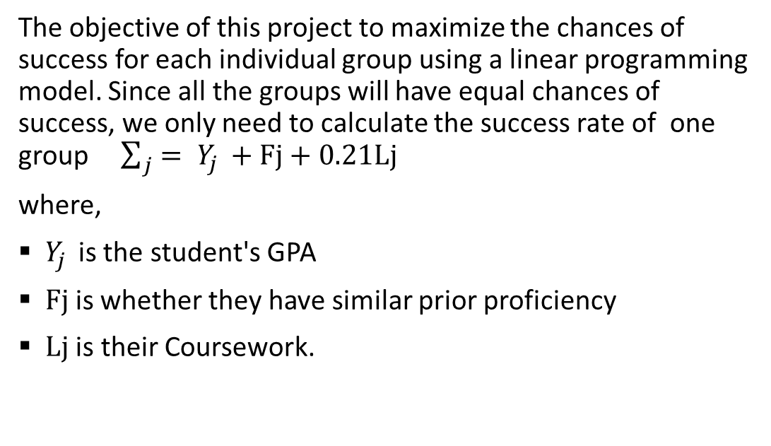
Model Formulation – Objective Function
The objective of this project to maximize the chances of success for each individual group using a linear programming model. Since all the groups will have equal chances of success, we only need to calculate the success rate of one group $\sum_{j}{= Y_{j }}+Fj+0.21Lj$
where,
$Y_{j }$is the student's GPA
$Fj$is whether they have similar prior proficiency
$Lj$ is their Coursework.

Slide 6

Constraints:
The constraints we have considered for this model are the following:
* The chances of success should be equal for all groups.
* Each group has exactly three members.
* A member must be in exactly one group at a time.

Slide 7

Results:
Group 1: Students - 1,8,10
Group 2: Students - 2,3,5
Group 3: Students - 4,7,11
Group 4: Students - 6,9,12

